Slide 1
OBJECT ORIENTED ANALYSIS and DESIGN
Project Management & Inception &
Analysis
UNIT II

Slide 2
Learning Objectives
Project Management & Inception Phase
Analysis
Introduction
The requirements model
The analysis model
UML: Use case Diagram, Class Diagram, Object Diagram, Activity Diagram, Sequence Diagram

Slide 3
Project Management & Inception phase

Slide 4
A lot of computer science people think:
“I don’t want to code for the rest of my life. Maybe I would enjoy managing the project.”
What do you think are some of the tasks you would be doing if you were a project manager?
Would you still code?
Would you miss coding ☺?
Is it important the project manager be able to code?

Slide 5
What is Project Management?
Project management encompasses all the activities needed to plan and execute a project:
  Deciding what needs to be done
  Estimating costs
  Ensuring there are suitable people to undertake the project
  Defining responsibilities
  Scheduling
  Making arrangements for the work
  continued ...

Slide 6
What is Project Management?
  Directing
  Being a technical leader
  Reviewing and approving decisions made by others
  Building morale and supporting staff
  Monitoring and controlling
  Co-ordinating the work with managers of other projects
  Reporting
  Continually striving to improve the process

Slide 7
Software Process Models
Software process models are general approaches for organizing a project into activities.
  Help the project manager and his or her team to decide:
    What work should be done;
    In what sequence to perform the work.
  The models should be seen as aids to thinking, not rigid prescriptions of the way to do things.
  Each project ends up with its own unique plan.
© Lethbridge/Laganière 2005
Chapter 11anaging the Software Process

Slide 8
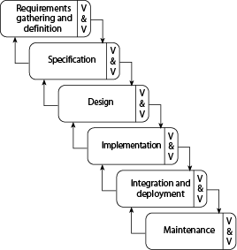
The waterfall model

Slide 9
The waterfall model
The classic way of looking at S.E. that accounts for the importance of requirements, design and quality assurance.
  The model suggests that software engineers should work in a series of stages.
  Before completing each stage, they should perform quality assurance (verification and validation).
  The waterfall model also recognizes, to a limited extent, that you sometimes have to step back to earlier stages.
  QUESTION: What is wrong with getting all the requirements completed upfront (like I have done for you with our project)?

Slide 10
Limitations of the waterfall model
  The model implies that you should attempt to complete a given stage before moving on to the next stage
    Does not account for the fact that requirements constantly change.
    It also means that customers can not use anything until the entire system is complete.
  The model makes no allowances for prototyping.
  It implies that you can get the requirements right by simply writing them down and reviewing them.
  The model implies that once the product is finished, everything else is maintenance.

Slide 11
Reengineering
Periodically project managers should set aside some time to re-engineer part or all of the system
  The extent of this work can vary considerably:
    Cleaning up the code to make it more readable.
    Completely replacing a layer.
    Re-factoring part of the design.
  In general, the objective of a re-engineering activity is to increase maintainability.

Slide 12
Cost estimation
To estimate how much software-engineering time will be required to do some work.
  Elapsed time
    The difference in time from the start date to the end date of a task or project.
  Development effort
    The amount of labour used in person-months or person-days.
    To convert an estimate of development effort to an amount of money:
      You multiply it by the weighted average cost (burdened cost) of employing a software engineer for a month (or a day).

Slide 13
Question
Assume that I gave your group the task of figuring out how much time you needed to code your project because you were going sell it online.
What are some techniques/ideas/concerns/thoughts you have for estimating the timing of a large project?
i.e. How do you decide/figure out how long it takes you to do an assignment?

Slide 14
Principles of effective cost estimation
Principle 1: Divide and conquer.
  To make a better estimate, you should divide the project up into individual subsystems.
  Then divide each subsystem further into the activities that will be required to develop it.
  Next, you make a series of detailed estimates for each individual activity.
  And sum the results to arrive at the grand total estimate for the project.

Slide 15
Principles of effective cost estimation
Principle 2: Include all activities when making estimates.
  The time required for all development activities must be taken into account.
  Including:
      Prototyping
      Design
      Inspecting
      Testing
      Debugging
      Writing user documentation
      Deployment.

Slide 16
Principles of effective cost estimation
Principle 3: Base your estimates on past experience combined with knowledge of the current project.
  If you are developing a project that has many similarities with a past project:
    You can expect it to take a similar amount of work.
  Base your estimates on the personal judgement of your experts
    or
  Use algorithmic models developed in the software industry as a whole by analyzing a wide range of projects.
    They take into account various aspects of a project’s size and complexity, and provide formulas to compute anticipated cost.

Slide 17
Algorithmic models
Allow you to systematically estimate development effort.
  Based on an estimate of some other factor that you can measure, or that is easier to estimate:
    The number of use cases
    The number of distinct requirements
    The number of classes in the domain model
    The number of widgets in the prototype user interface
    An estimate of the number of lines of code

Slide 18
Algorithmic models
  A typical algorithmic model uses a formula like the following:
    COCOMO:
    Functions Points:
E = a + bN^{c}
S = W₁F₁ + W₂F₂ +W₃F₃ + …
Notes:
E effort
N number of requirements or use cases or lines of code
S system size
W weight
F Feature → number of inputes, tables in a database, usecases, etc

Slide 19
Principles of effective cost estimation
Principle 4: Be sure to account for differences when extrapolating from other projects.
  Different software developers
  Different development processes and maturity levels
  Different types of customers and users
  Different schedule demands
  Different technology
  Different technical complexity of the requirements
  Different domains
  Different levels of requirement stability

Slide 20
Principles of effective cost estimation
Principle 5: Anticipate the worst case and plan for contingencies.
  Develop the most critical use cases first
    If the project runs into difficulty, then the critical features are more likely to have been completed
  Make three estimates:
    Optimistic (O)
      Imagining a everything going perfectly
    Likely (L)
      Allowing for typical things going wrong
    Pessimistic
      Accounting for everything that could go wrong

Slide 21
Principles of effective cost estimation
Principle 6: Combine multiple independent estimates.
  Use several different techniques and compare the results.
  If there are discrepancies, analyze your calculations to discover what factors causing the differences.
  Use the Delphi technique.
    Several individuals initially make cost estimates in private.
    They then share their estimates to discover the discrepancies.
    Each individual repeatedly adjusts his or her estimates until a consensus is reached.

Slide 22
Principles of effective cost estimation
Principle 7: Revise and refine estimates as work progresses
  As you add detail.
  As the requirements change.
  As the risk management process uncovers problems.

Slide 23
Skills needed on a team
  Architect
  Project manager
  Configuration management and build specialist
  User interface specialist
  Technology specialist
  Hardware and third-party software specialist
  User documentation specialist
  Tester

Slide 24
Project Scheduling and Tracking
  Scheduling is the process of deciding:
    In what sequence a set of activities will be performed.
    When they should start and be completed.
  Tracking is the process of determining how well you are sticking to the cost estimate and schedule.

Slide 25
Some Basic Project Management Terminology
Deliverable: some concrete thing which is to be delivered, to the client or internally to the development team; e.g.
  Specifications reports
  Executable program
  Source code
Task/Activity: something we have to do during the project; e.g.
  Defining user requirements
  Coding a module
  Doing system testing
Each task or activity will take some length of time
  Referred to as duration of task
  Sometimes measured in days, weeks, etc.
  Sometimes measured in person-days, person-weeks, etc.
  Person-day = number of people X number of days
    Example: 12 person days for writing all code could mean 1 person 12 days or 4 people 3 days
    Note: not always true that a task that takes 1 programmer 12 days would take 12 programmers 1 day

Slide 26
Dependencies and Milestones
For a given task or activity, may be impossible to start it without some other task(s) or activity(ies) having been completed; e.g.
  Cannot start coding without completing design
  Cannot start system testing without completing code integration and test plan
If task B cannot start without A being completed, we say
  B depends on A
  There is a dependency between A and B
Milestone: some achievement which must be made during the project; e.g.
  Delivering some deliverable
  Completing some task
Note, delivering a deliverable may be a milestone, but not all milestones are associated with deliverables

Slide 27
Setting and Making Deadlines
Deadline time by which milestone has to be met
  Some deadlines are set by the client
  Others are set by us on project to make sure project stays on track
To set a deadline for completing task T, we must consider how long it will take to:
  Complete the tasks that task T depends on
  Complete task T itself
If we miss a deadline, we say (euphemistically) “the deadline has slipped”
  This is virtually inevitable
Important tasks for project managers
  Monitor whether past deadlines have slipped
  Monitor whether future deadlines are going to slip
  Allocate or reallocate resources to help make deadlines
PERT chart and Gantt charts help project managers do these things (among others)

Slide 28
PERT Charts
PERT = Project Evaluation and Review Technique
PERT chart = graphical representation of the scheduling of events in a project
Sample PERT Chart:
A PERT chart is a graph
  Edges are tasks/activities that need to be done
  Nodes are the events or milestones
Task edge T from event node E1 to event node E2 signifies:
  Until event E1 happens, task T cannot be started
  Until task T finishes, event E2 cannot happen
Events often simply represent completion of tasks associated with arrows entering it
6
3
10
E
B
3
13
0
4
2
6
A
13
1
4
2
F
0
4
C
7
D
10
3
3
4
3
5
7
10

Slide 29
PERT Chart Task Edges
Parts of a task/activity edge
Task letter:
  Often keyed to a legend to tell which task it represents
Task duration = how long (e.g. days, hours) task will take
Task letter
D
5
Task duration

Slide 30
PERT Chart Event Nodes
Event Number:
Sequence number assigned
Only task edges indicate dependencies
Earliest Completion Time (ECT):
Earliest time this event can be achieved, given durations and dependencies
9
5
19
Latest Completion Time (LCT):
Latest time that this event could be safely achieved

Slide 31
Building a PERT Chart
Steps:
Make a list of all project tasks (and events if possible).
Find interrelated task dependencies (what task has to be completed before other tasks)
Draw initial PERT without durations, ECTs or LCTs
Estimate duration of each task
Fill in durations
Calculate ECTs and LCTs
We will do this for an example system:
  → Generic software system with 3 modules

Slide 32
Example: Generic Software Project
TASK ID Task Description
A Specification
B High Level Design
C Detailed Design
D Code/Test Main module
E Code/Test DB module
F Code/Test UI module
G Write test plan
H Integrate/System Test
I Write User Manual
J Typeset User Manual
To start PERT chart: identify dependencies between tasks

Slide 33
Dummy Tasks
Sometimes it is necessary to use dummy tasks:
  Shows the dependency between 2 events where no activity is performed
Example:
  Events 3, 4 signify the compilation of separate modules.
  Create an event 5 to signify “all modules compiled together”.
Denote dummy tasks using dash lines
9
3
10
T
9
5
12
3
9
4
12

Slide 34
Example: Tasks with Dependencies
To start the PERT, identify the dependencies amongst tasks
TASK ID Task Description Preceed ID Succ. ID
A Specification 1 2
B High Level Design 2 3
C Detailed Design 3 4
D Code/Test Main 4 5
E Code/Test DB 4 6
F Code/Test UI 4 7
G Write test plan 4 8
Dummy Task 5 8
Dummy Task 6 8
Dummy Task 7 8
H Integrate/System Test 8 9
I Write User Manual 8 10
J Typeset User Manual 10 9

Slide 35
Software Example: Skeleton PERT Chart
5
D
A
B
C
E
H
1
2
3
4
6
8
9
I
F
J
7
1
G
Note: dummy tasks connecting events 5, 6 and 7 to 8

Slide 36
Estimating Durations
Suggestions for estimating durations of tasks:
  Don’t just make up a number
  Look at previous similar tasks from other projects and use those as guidelines
  Try to identify factors such as difficulty, skill level
    Each weighting factor will help you make a better estimate
Factors to consider:
  Difficulty of task
  Size of team
  Experience of team
  Number, attitude and availability of end users
  Management commitment
  Other projects in progress

Slide 37
PERT Chart With Durations
5
D
7
A
B
C
E
H
1
2
3
4
6
8
5
9
3
2
2
6
F
I
J
2
1
3
7
1
G
2
Say we have estimated durations of all tasks (in days)
New PERT chart, with durations filled in:
Note, dummy tasks (dashed lines) always have a duration of zero
Notes:
Dummy tasks always have 0 duration.
From this, we can calculate ECTs and LCTs

Slide 38
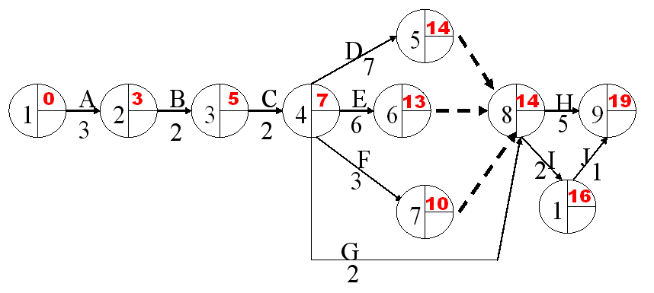
Calculating ECTs
ECT = earliest time event can be completed
To calculate:
  For an event not depending on others: ECT = 0
    Usually this is the first event
  For an event E depending on one or more others:
    Calculate ECTs of event(s) that E depends on
    Add duration(s) of task(s) leading to E
    If E depends on more than one event, take MAX
Proceed left to right ( → ) through the chart
Exercise: calculate the ECT for our example.

Slide 39
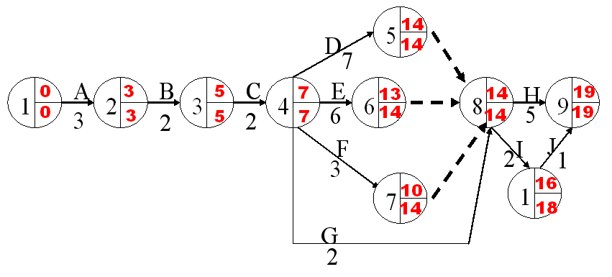
Calculating LCT
LCT = latest time event can be completed, while still finishing last ask at indicated time
To calculate:
  For an event which no other events depend on: LCT = ECT
    Generally there will only be one such event
  For an event E which one or more others depend on:
    Calculate LCTs of event(s) that depend on E
    Subtract duration(s) of task(s) leading from E
    If more than one event depends on E, take MINIMUM
Proceed right to left ( ← ) through PERT chart
Exercise: calculate LCT for our example

Slide 40
Critical Path
Red line is the critical path
What does it represent?

Slide 41
Uses of PERT Charts
We can use PERT charts for:
  Determining the estimated time to complete a project
  Deriving actual project dates
  Allocating resources
  Identifying potential and current problems (is one task behind schedule?, can we shuffle people?)
Critical Path: Path through chart such that if any deadline slips, the final deadline slips (where all events have ECT = LCT (usually there is only one)
In software example:
  Task I is not on the critical path: even if we don’t finish it until time 18, we’re still okay
  Task D is on the critical path: if we don’t finish it until for example, time 16, then:
    We can’t start task H (duration 3) until time 16
    So we can’t complete task H until time 21
We can use PERT charts for
  Identifying the critical path
  Reallocating resources, e.g. from non-critical to critical tasks.

Slide 42
PERT Chart Exercise
Task Prec Tasks Description Time(hrs)
A none decide on date for party 1
B A book bouncy castle 1
C A send invitations 4
D C receive replies 7
E D buy toys and balloons 1
F D buy food 3
G E blow up balloons 2
H F make food 1
I H, G decorate 1
J B get bouncy castle 1
K J, I have party 1
L K clean up 4
M K send back bouncy castle 1
N L send thank you letters 3
O M donate unwanted gifts 3

Slide 43
Gantt Charts
Graphical Representation of a schedule
Helps to plan, coordinate and track specific tasks in a project
Named after Henry Gantt who invented them in 1917
Depicts some of the same information as on a PERT chart
Also depicts new information

Slide 44
Example Gantt Chart
TASKS
A Study current email system
B Define end-user requirements
C Design Class diagram
D Acquire computer technology
E Plan & code email modules
F Acceptance test new system
G Deliver new system
1 2 3 4 5 6 7 8 9 10 11 12
Today
Questions: From the above, can you guess:
  Which, if any, tasks should have been completed by today and aren’t even started? ______
  Which, if any, tasks have been completed? ______
  Which, if any, tasks have been completed ahead of schedule:? ______
  Which, if any, tasks are on or ahead of schedule? _________
  Which, if any, tasks are behind schedule? ________

Slide 45
Building and Using a Gantt Chart
Steps for building a Gantt Chart
  Identify the tasks to be scheduled
  Determine the durations of each task
  List each task down the vertical axis of chart
    In general, list tasks to be performed first at the top and then move downward as the tasks will happen
  Use horizontal axis for the dates
  Determine start and finish dates for activities
    Consider which tasks must be completed or partially completed before the next task
To use the Gantt chart to report progress:
  If the task has been completed, completely shade in the bar corresponding to the task
  If the task has been partially completed, shade in the percentage of the bar that represents the percentage of the task that has been completed
  Unshaded bars represents tasks that have not been started.

Slide 46
Gantt Chart: Exercise
Task Prec Tasks Description Time(hrs)
A none decide on date for party 1
B A book bouncy castle 1
C A send invitations 4
D C receive replies 7
E D buy toys and balloons 1
F D buy food 3
G E blow up balloons 2
H F make food 1
I H, G decorate 1
J B get bouncy castle 1
K J, I have party 1
L K clean up 4
M K send back bouncy castle 1
N L send thank you letters 3
O M donate unwanted gifts 3

Slide 47
Gantt Chart: Exercise
Draw the Gantt chart using the following criteria:
  label hours 0 to 30 across the horizontal axis
  Mark a review stage at hour 14 to monitor the progress
  Assume and illustrate that tasks A, B, C and D have been completed at hour 14
  State which tasks are ahead and which tasks are behind schedule
  NOTE: if you are using MS Project and want a different unit of time, just type 2 hours (instead of 2 days). ALSO, if you want to have a milestone, like Handing in Group Assignment 1, then give it a ZERO duration.

Slide 48
PERT vs. Gantt
PERT chart
  All us to show dependencies explicitly
  Allow us to calculate critical path
  Can tell us how one task falling behind affects other tasks
Gantt charts
  Allow us to record progress of project
  Allow us to see what tasks are falling behind
  Allow us to represent overlapping tasks
Project Management Tools, e.g. MS Project
  Allow us to specify tasks, dependencies, etc
  Allow us to specify progress on tasks, etc
  Can generate either PERT or Gantt charts (whichever we want) from data entered

Slide 49
Difficulties and Risks in Project Management
  Accurately estimating costs is a constant challenge
    Follow the cost estimation guidelines.
  It is very difficult to measure progress and meet deadlines
    Improve your cost estimation skills so as to account for the kinds of problems that may occur.
    Develop a closer relationship with other members of the team.
    Be realistic in initial requirements gathering, and follow an iterative approach.
    Use earned value charts to monitor progress.

Slide 50
Difficulties and Risks in Project Management
  It is difficult to deal with lack of human resources or technology needed to successfully run a project
    When determining the requirements and the project plan, take into consideration the resources available.
    If you cannot find skilled people or suitable technology then you must limit the scope of your project.

Slide 51
Difficulties and Risks in Project Management
  Communicating effectively in a large project is hard
    Take courses in communication, both written and oral.
    Learn how to run effective meetings.
    Review what information everybody should have, and make sure they have it.
    Make sure that project information is readily available.
    Use ‘groupware’ technology to help people exchange the information they need to know

Slide 52
Difficulties and Risks in Project Management
  It is hard to obtain agreement and commitment from others
    Take courses in negotiating skills and leadership.
    Ensure that everybody understands
      The position of everybody else.
      The costs and benefits of each alternative.
      The rationale behind any compromises.
    Ensure that everybody’s proposed responsibility is clearly expressed.
    Listen to everybody’s opinion, but take assertive action, when needed, to ensure progress occurs.

Slide 53
Review
Draw a PERT Chart for the following activities:
Activity | Description | Predecessor | Estimated Time
A | Drive home | None | 0.5
B | Wash Clothes | A | 4.0
C | Pack | B | 0.5
D | Go to bank | A | 1.0
E | Pay bill | D | 0.5
F | Pack car | C,E | 0.5
G | Drive to bus | F | 0.5

Slide 54
OOSE Analysis Models
Object-oriented software engineering (OOSE) proposes two analysis models for understanding the problem domain
    • Requirements Model
    • Analysis Model
  The requirements model serves two main purposes
    • To delimit the system
    • To define the system functionality

Slide 55
Requirement Model
Conceptual model of the system is developed using:
  • Problem domain objects
  • Specific interface descriptions of the system (if meaningful to the system being developed)
⊗ The system is described as a number of use cases that are performed by a number of actors
  • Actors constitute the entities in the environment of the system
  • Use cases describe what takes places within the system
  • A use case is a specific way of using the system by performing some part of the system functionality

Slide 56
Requirement Model
Use Case Model
May be expressed in terms of
Tested in
Realiz ed by
Structured by
Impleme nted by
Class..
OK
OK
Fail
Analysis model
Design Model
Implementation Model
Testing Model
Domain Object Model

Slide 57
Requirement Model
The requirements model for the will comprise three main models of representation:
    • The use case model
    • The problem domain model
    • User interface descriptions

Slide 58
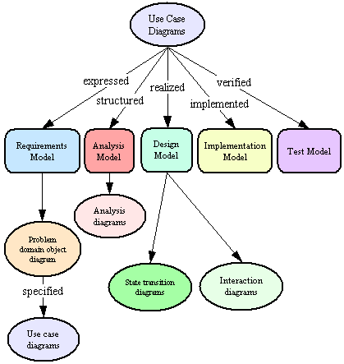
Requirement Model

Slide 59
Actors
In order to identify use cases to be performed in the system, we need to first identify system users
The system users are referred to as actors.
Actors model the prospective ‘users’ of the system.
An actor is a user type or category. When an actor does something, the actor acts as an occurrence of that type.
An actor may represent a person or another system interacting with the intended system

Slide 60
Actors and Role Play
One person can instantiate (play the roles of) several different actors
Actors define the roles that users can play
Actors model anything that needs to exchange information with the system.
Actors can model human users but they can also model other systems communicating with the intended system

Slide 61
Identifying Actors
Actors constitute anything external to the system
Identifying all the relevant actors for a system may require several iterations
General guidelines include the following:
    • Ask yourself why the system is been developed
    • Who are people the system is intended to help?
    • What other systems are likely to interface with new system?

Slide 62
Primary and Secondary Actors
Actors who use the system directly (or in their daily work) are known as Primary actors
Primary actors are associated with one or more of the main tasks of the system
Primary actors govern the system structure. Thus when identifying use cases, we first start with the primary actors
Actors who are concerned with supervising and maintaining the system are called secondary actors
The distinction between the primary and secondary actors has a bearing on the system structuring

Slide 63
Use Cases
After the actors have been identified the next step is to define the functionality of the system. This is done by specifying use cases.
Actors are a major tool in finding use cases. Each actor will perform a number of use cases in the system.
Each use case constitutes a complete course of events initiated by an actor and specifies the interaction that takes place between the actor and the system
A use case is a special sequence of related transactions performed by an actor and the system in dialogue.
The collective use cases should specify all the existing ways of using the system

Slide 64
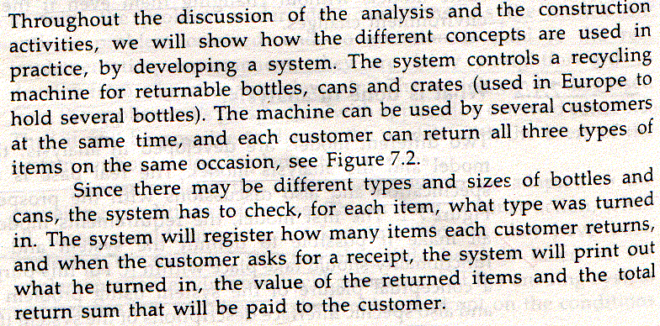
Recycling Machine Example

Slide 65
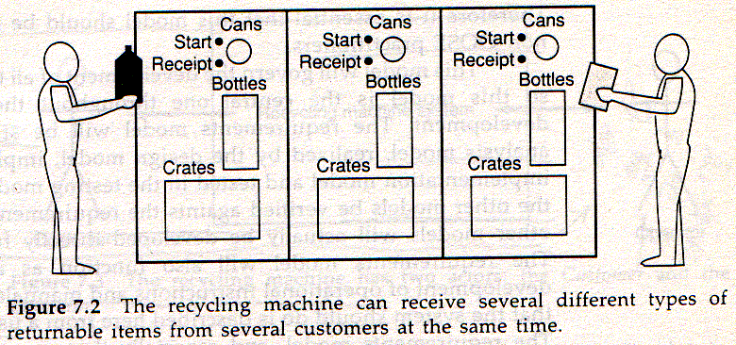
Recycling Machine Example

Slide 66
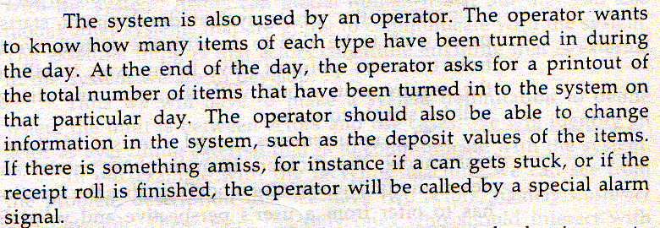
Recycling Machine Example

Slide 67
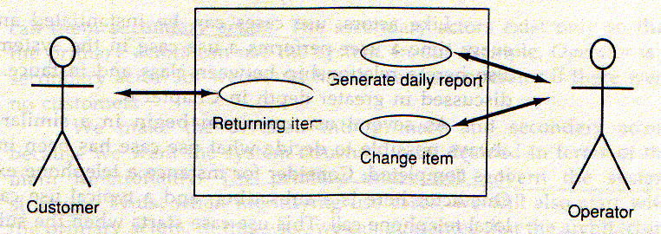
Use Case Diagram

Slide 68
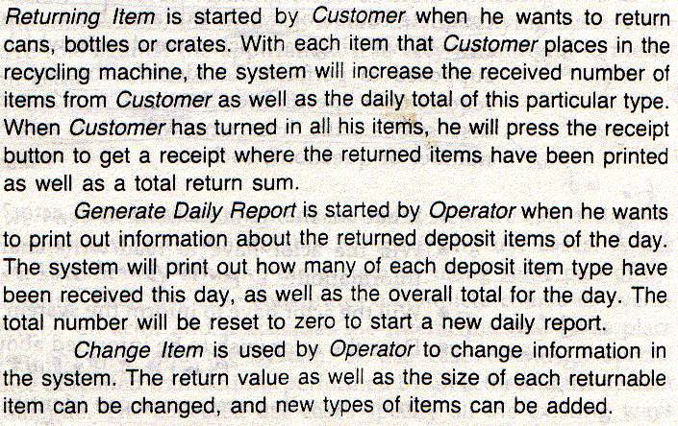
Use Case Description

Slide 69
Case Study
Consider a telephone exchange:
• One actor is a subscriber and a typical use case to make a local telephone call. This use starts when the subscriber lifts his telephone receiver.
• Another use case is to order a wake-up call.
• Both use cases start when the subscriber lifts the telephone.
• However, when the subscriber lifts his telephone, its not obvious which use case he would like to perform.
• Thus uses cases may begin in a similar manner but we may not know which use case is to be carried out until its over.
• The actor should be viewed as someone who initiates a course of events that eventually results in a complete use case. Rather than someone who demands that a use case be performed.

Slide 70
Use Case Relationships- Include
Use case include is a directed relationship between two use cases which is used to show that behaviour of the included use case (the addition) is inserted into the behaviour of the including (the base) use case.
The include relationship could be used:
  To simplify large use case by splitting it into several use cases,
  To extract common parts of the behaviours of two or more use cases.
A large use case could have some behaviours which might be detached into distinct smaller use cases to be included back into the base use case using the UML include relationship.
The purpose of this action is modularization of behaviours, making them more manageable.

Slide 71
Use Case Relationships- Extend
Extend is a directed relationship that specifies how and when the behaviour defined in usually supplementary (optional) extending use case can be inserted into the behaviour defined in the extended use case.
Extended use case is meaningful on its own, it is independent of the extending use case.
Extending use case typically defines optional behaviour that is not necessarily meaningful by itself.
The extension takes place at one or more extension points defined in the extended use case.
Extend relationship is shown as a dashed line with an open arrowhead directed from the extending use case to the extended (base) use case.

Slide 72
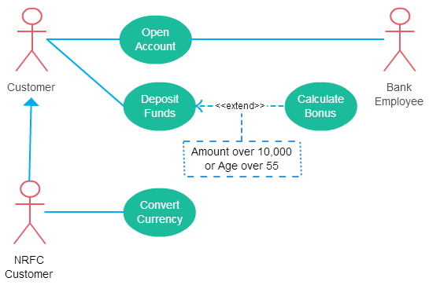
Use Case Relationships

Slide 73
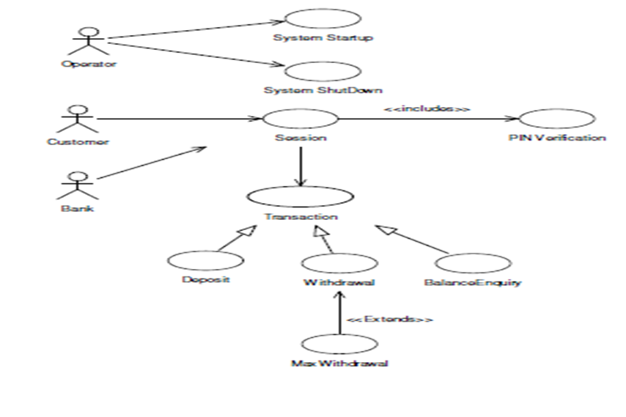
Banking System Use Case Diagram

Slide 74
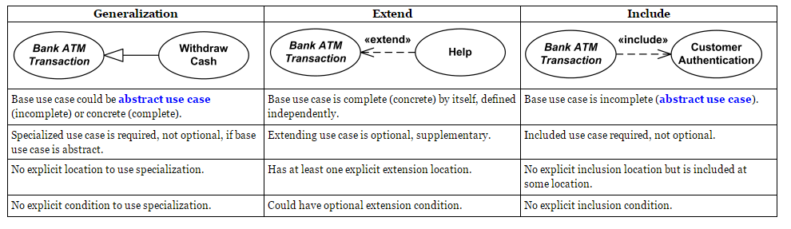
A Comparative Study

Slide 75
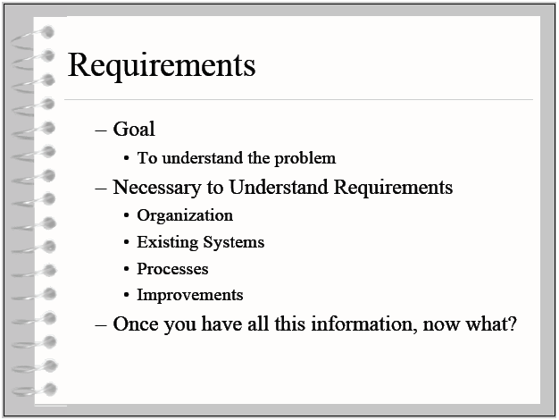
Requirement Engineering

Slide 76

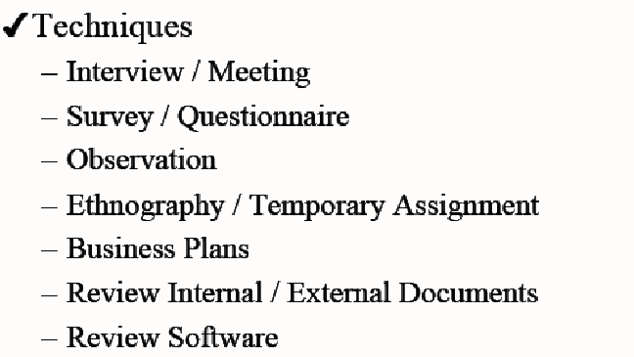
Requirement Elicitation

Slide 77
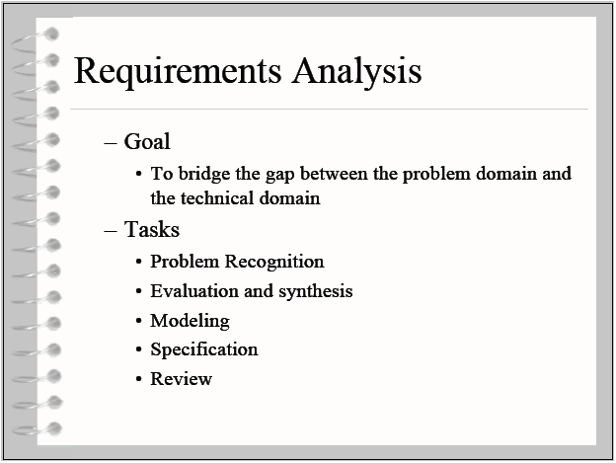
Requirement Analysis

Slide 78
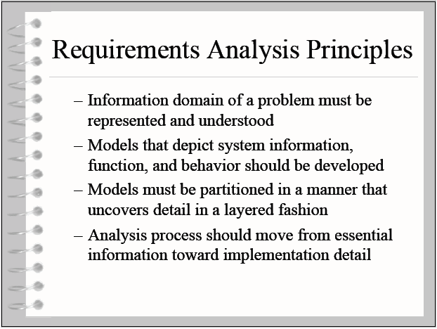
Requirement Analysis Principles

Slide 79
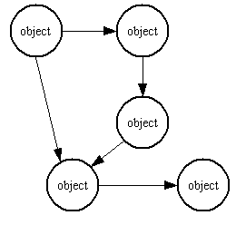
Problem Domain Object Model
Provides a logical view of the system, which is used to specify the use cases for use case diagrams

Slide 80
Object Oriented Analysis
  Identifying objects: Using concepts, CRC cards, stereotypes, etc.
  Organising the objects: classifying the objects identified, so similar objects can later be defined in the same class.
  Identifying relationships between objects: this helps to determine inputs and outputs of an object.
  Defining operations of the objects: the way of processing data within an object.
  Defining objects internally: information held within the objects.

Slide 81
Object Oriented Analysis Approaches
1.Analysis model with stereotypes (Jacobson)
  Boundaries, entities, control.
2.CRC cards (Beck, Cunningham)
  Index cards and role playing.
3.Conceptual model (Larman)
  Produce a “light” class diagram.
A good analyst knows more than one strategy and even may mix strategies

Slide 82
The Analysis Phase
Begins with a problem statements generated during system conception.
In software engineering, analysis is the process of converting the user requirements to system specification (system means the software to be developed).
System specification, also known as the logic structure, is the developer’s view of the system.
Function-oriented analysis
  Concentrating on the decomposition of complex functions to simply ones.
Object-oriented analysis
  Identifying objects and the relationship between objects.

Slide 83
Analysis Model
  ⊗ The analysis model gives a conceptual configuration of the system.
    It consists of:
      • The entity objects
      • Control objects
      • Interface objects
  ⊗ The analysis model forms the initial transition to object-oriented design

Slide 84
Dimensions of Analysis Model
Dimensions of the analysis model
Behavior
Information
presentation

Slide 85
Analysis Model- Objects
Entity object
  Information about an entity object is stored even after a use case is completed.
Control object
  A control object shows functionality that is not contained in any other object in the system
Interface object
  Interface objects interact directly with the environment

Slide 86
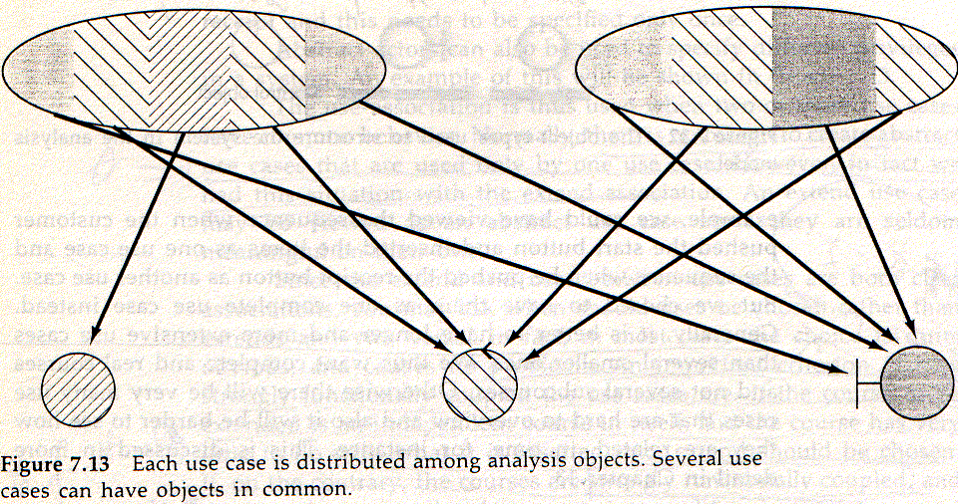
Requirement Model Structured in Analysis Model

Slide 87
Design Model
Developed based on the analysis model
  Implementation environment is taken into consideration
The considered environment factors includes
  Platform
  Language
  DBMS
  Constraints
  Reusable Components
  Libraries
  so on..

Slide 88
Design Model
Design objects are different from analysis objects
Models
  Design object interactions
  Design object interface
  Design object semantics
    (i.e., algorithms of design objects’ operations)
More closer to the actual source code

Slide 89
Design Model Dimensions
Dimensions of the Design model
Behavior
Implementation
Environment
Information
presentation

Slide 90
Design Model
Use block term in place of object
Sent from one block to another to trigger an execution
A typical block is mapped to one file
To manage system abstractly subsystem concept is introduced
Analysis Model is viewed as conceptual and logical model, whereas the design model should take as closer to the actual source code
Consist of explained source code
OO language is desirable since all fundamentals concepts can easily be mapped onto language constructs
Strongly desirable to have an easy match between a block and the actual code module

Slide 91
Implementation Model
Consists of annotated source code.
Object oriented language is desirable since all fundamental concepts can be easily mapped onto language constructs.
Strongly desirable to have an easy match between a block and the actual code module.

Slide 92
Test Model
Fundamental concepts are test specifications and the test results

Slide 93
Analysis

Slide 94
Learning Objectives
The Analysis Phase
Analysis Model
Meta Model of Analysis Model
Analysis workflow details
Analysis model-rules of thumb
Object Oriented Analysis
Three ways to do Object Oriented Analysis
Conceptual Model – Overview
The Concept Category List
Finding Concepts with
Noun Phrase Identification

Slide 95
Learning Objectives
Exercise
How to make a conceptual model
Drawing of Concepts
Adding Associations
Adding Attributes
The Object Oriented Analysis Model (Jacobson)
Subsystem
Good Analysis class
Bad Analysis class

Slide 96
Analysis Model
The analysis model is intended to define a first structure of the system to be designed in the form of a class and/or an object diagram.
The analysis model, gives the system its initial structure which is subject to further refinement in later development steps.
According to the Unified Process, the development of the analysis model has to occur on the basis of the use case specifications.
The analysis model has to be capable to fulfill the functional requirements stated in the use case descriptions.

Slide 97
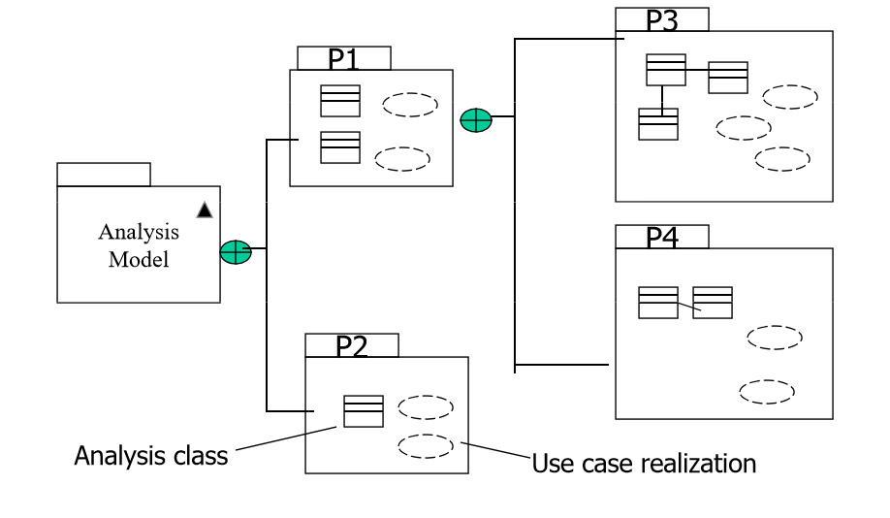
Meta Model of Analysis Model

Slide 98
Analysis Model- Rule of Thumb
50 to 100 analysis classes in analysis model in an average system
Include classes from the vocabulary of the problem domain
Do not make implementation decisions
Focus on classes and associations- minimize coupling
Use inheritance whenever needed
Keep it simple

Slide 99
The Object Oriented Analysis Model (Jacobson)
An analysis model is used to represent the system specification.
To achieve robustness and stability the model must be implementation environment independent.
Any change in the implementation environment will not affect the logical structure of the system.
The model must be able to capture information, behaviour (operations) and presentation (inputs and outputs).

Slide 100
Behaviour - Information - Presentation
The model is defined in information - behaviour - presentation space.
behaviour
information
presentation

Slide 101
OO Analysis Model Syntax
Within an use case, we employ three types of objects
In Rational Rose, known as three types of entities or stereotypes
On information – behaviour plane and incline to information axis
Entity
Boundary / Interface
On the presentation axis
On information – behaviour plane but incline towards behaviour axis
Control

Slide 102
Entity, Control, Interface
behaviour
information
presentation

Slide 103
Pragmatics of OO Analysis Model
Identifying interface objects
  functions directly related to actors.
Identifying entity objects
  information used in an use case and functions of processing the information.
Identifying control objects
  functions that link interface objects and entity objects

Slide 104
Semantics of OO Analysis Model
An entity object models information that shows the state of a system.
  This information is often used to record the effects of operations
  Related to the behaviour of the system.
A boundary/interface object models inputs and outputs and operations that process them.
A control object models functionality/operations regarding to validate and decide whether to process and pass information from the interface object to the entity object or the way around.

Slide 105
Semantics of OO Analysis Model
Interface objects: Mediate the communication with the actors. They directly correspond to the actor/system interfaces.
Entity objects: are objects to hold information. They often correspond to the objects in reality and can be found by conceptual domain modeling.
Control objects: are those objects which coordinate and allocate work between the different objects in fulfillment of a particular use case.

Slide 106
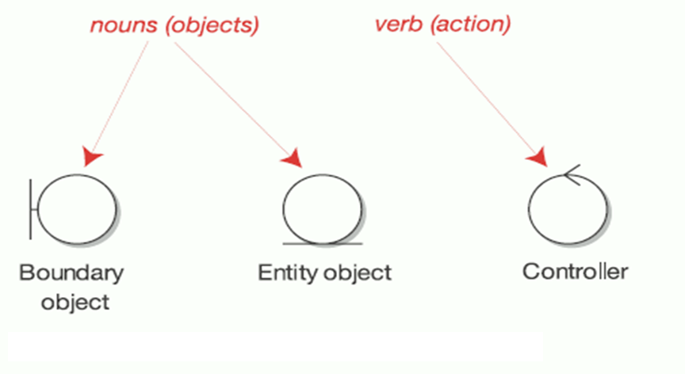
Noun-Verb Conjunction

Slide 107
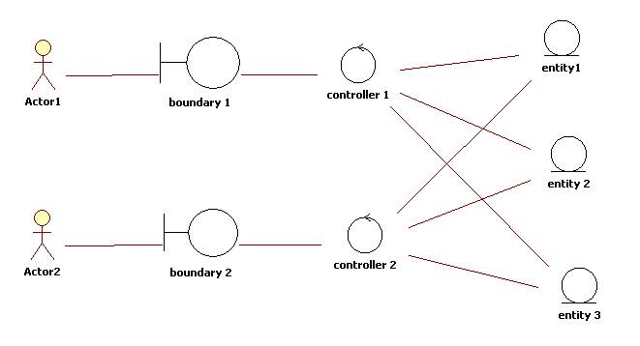
Analysis Model Structure

Slide 108
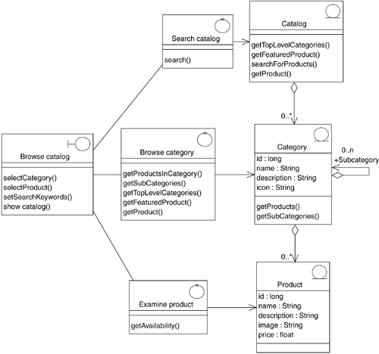
Another Representation…

Slide 109
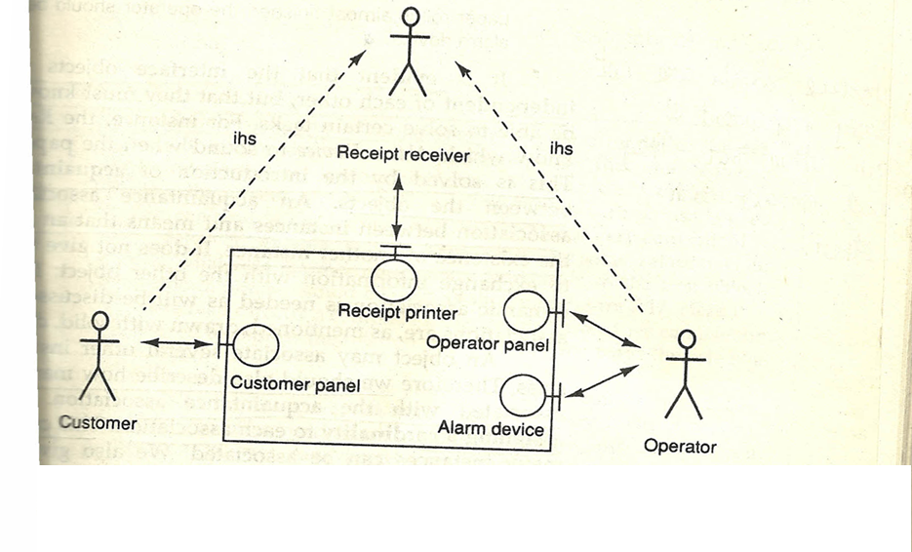
Recycling Machine Case Study

Slide 110
Recycling Machine Case Study
Identifying interface objects
  Printer, Customer Panel
Identifying entity objects
  Long term information: Crate, Bottle, Can
  Superclass: Deposit item
  Short term information: Receipt basis
Identifying control objects
  Deposit item receiver

Slide 111
Recycling machine: Interface Objects
Customer panel
Receipt printer

Slide 112
Recycling machine: Entity Objects
Receipt basis
Deposit items
Can
Bottle
Crate

Slide 113
Link Interface and Entity Objects by a Control Object
Deposit item receiver
Customer panel
Receipt printer
Receipt basis
Deposit items
Can
Bottle
Crate

Slide 114
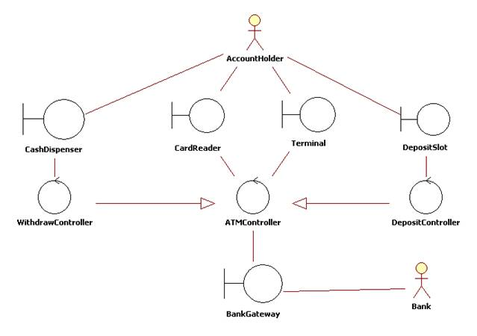
ATM Machine Analysis Model

Slide 115
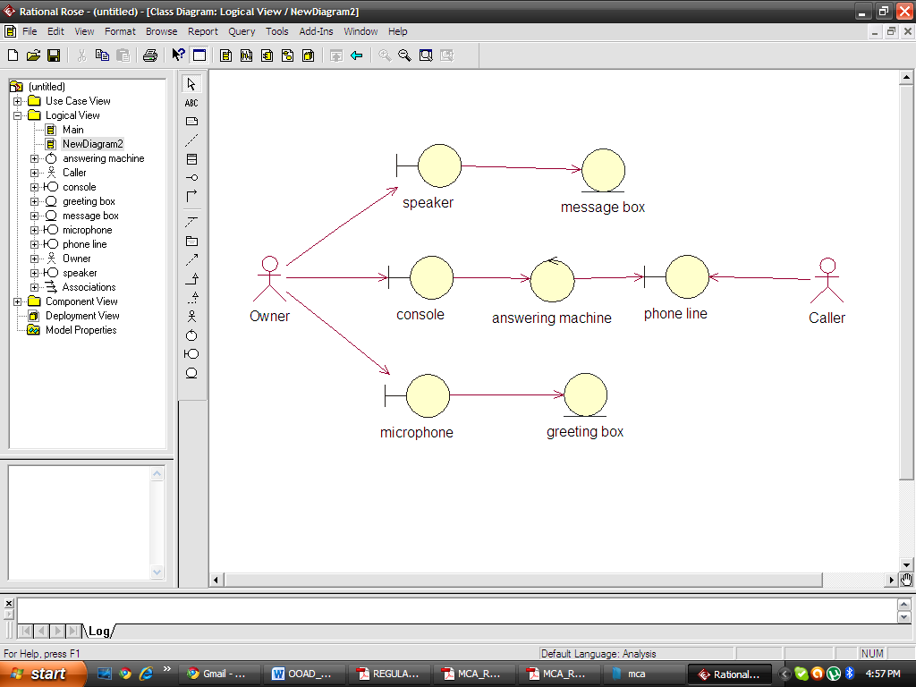
Telephonic System Analysis Model

Slide 116
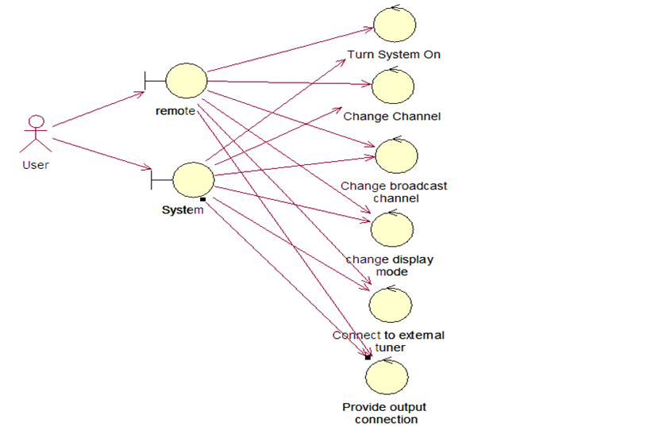
Television Control Analysis Model

Slide 117
Subsystem in Analysis Model
Package the objects so that complexity is reduced
Lowest level is service package
Little communication between different subsystem as possible

Slide 118
Subsystem in Analysis Model
The aim is to have strong functional coupling within the subsystem and a weak coupling between subsytem
  Whether two objects are strongly functionally?
  Will changes in one object lead to changes in the other object?
  Do they communicate with the same actor?
  Are both of them dependent on a third object, such as an interface object or an entity object?
  Does one object perform several operations on the other?

Slide 119
Subsystem in Recycling machine
Administrator
Alarm
Alarmist
Report Generator
Alarm Device
Operator Panel
extends
Deposit
Deposit item receiver
Receipt printer
Customer panel
Receipt basis
Deposit items
Crate
Can
Bottle

Slide 120
Good Analysis Class Characteristic
Name reflects its goal
Hard abstraction that models one specific element of the problem domain
Maps to a clearly identifiable feature of the problem domain
Has a small, well-defined set of responsibilities

Slide 121
Drawing of Concepts
Customer panel
Deposit item receiver
Deposit item
Receipt printer
Receipt basis
Can
Bottle
Crate

Slide 122
Adding Associations
If one concept needs to know of a another concept for some duration they should be linked by an association.
Also use the Common Association list in order to identify associations.

Slide 123
Adding Associations
The Deposit item receiver manages Deposit items:
The items are classified.
Customer panel
initiate action
Deposit item receiver
classifies
Deposit item
Receipt basis
Receipt printer
Can
Bottle
Crate

Slide 124
Adding Associations
The Deposit item receiver communicates to Receipt basis:
Items received and classified are stored.
It also creates the receipt basis when it is needed for the first time.
Customer panel
initiates action
Deposit item receiver
creates & inform
classifies
Deposit item
Receipt basis
Receipt printer
Can
Bottle
Crate

Slide 125
Adding Associations
The Receipt basis collects Deposit items.
Customer panel
initiates action
Deposit item receiver
creates & notifies
classifies
captures
Deposit item
Receipt basis
Receipt printer
Can
Bottle
Crate

Slide 126
Adding Associations
On request by the Customer Panel the Deposit item receiver initiates printing of a receipt on the printer.
Customer panel
initiates action
Deposit item receiver
creates & notifies
classifies
captures
Deposit item
prints on
Receipt basis
Receipt printer
Can
Bottle
Crate

Slide 127
Adding Associations
Adding multiplicities
Only one association here is a 1 to many relationship
All others are 1 to 1.
Customer panel
initiates action
Deposit item receiver
creates & notifies
classifies
captures
Deposit item
prints on
1..*
Receipt basis
Receipt printer
Can
Bottle
Crate

Slide 128
Adding Attributes
An attribute is a logical data value of an object.
Attributes in a conceptual model are simple data values as
  Boolean, Date, Number, String (Text), Time, Address, Colour, Price, Phone Numbers, Product Codes, etc.
Sometimes it is difficult to distinguish between attributed and concepts
  E.g. Concept “Car” vs. attribute “Reg. Number”.

Slide 129
Adding Attributes
The Deposit item has a value.
Also it will be assigned a number that shows later on the receipt.
Customer panel
initiates action
Deposit item receiver
creates & notifies
classifies
captures
Deposit item
number
value
prints on
1..*
Receipt basis
Receipt printer
Can
Bottle
Crate

Slide 130
Adding Attributes
In order to be classified by the Deposit item receiver each item has also a weight and a size.
However this is the same for each type of item, but different between the types.
Customer panel
initiates action
Deposit item receiver
creates & notifies
classifies
captures
Deposit item
number
value
prints on
1..*
Receipt basis
Receipt printer
Can
weight
size
Bottle
weight
size
Crate
weight
size

Slide 131
Conceptual Model
Representation of concepts in a problem domain.
In UML it is basically a “class diagram” without operations.
It may show
    Concepts
    Associations
    Attributes

Slide 132
The Concept Category List
physical or tangible objects
specifications, designs, descriptions of things
places
transactions
transaction line items
roles of people
abstract noun concepts
organisations
events
processes
rules and policies
catalogues
records
services
manuals, books

Slide 133
Noun Phrase Identification
Identify the noun and noun expression in textual descriptions of a problem domain
Consider them as concepts and attributes.
Mechanical noun-to-concept mapping isn’t possible
Words in usual languages are ambiguous (especially English).

Slide 134
The “return item” Use case-Exercise: Find the Nouns!
The system controls a recycling machine for returnable bottles, cans and crates. The machine can be used by several customers at the same time and each customer can return all three types of item on the same occasion. The system has to check, for each item, what type has been returned.
The system will register how many items each customer returns and when the customer asks for a receipt, the system will print out what was deposited , the value of the returned items and the total return sum that will be paid to the customer.
An operator also … (not in “return item” Use Case)

Slide 135
Case Study: Nouns found in the description
recycling machine
bottles, cans, and crates
customers, customer
types of item, item, type, returned items
system
receipt
return sum

Slide 136
Case Study: Discussion of “recycling machine”.
recycling machine
bottles, cans and crates
machine
customers, customer
types of item, item, type, returned items
system
receipt
return sum
This concept is the “overall system”
As we consider only one single use case,
better to name this concept in the context of this use case, e.g.
  Deposit item receiver

Slide 137
Case Study: Discussion of “bottles, cans, and crates”.
deposit item receiver
bottles, cans, and crates
machine
customers, customer
types of item, item, type returned items
system
receipt
return sum
Usually better to use singular and multiplicities instead of plural.
As bottle, can and crate have much in common (they are processed as items),
they could be generalised to an “item”. We should remember this for later (inheritance).

Slide 138
Case Study: Discussion of “machine” and “system”
deposit item receiver
bottle, can, crate
machine
customers, customer
types of item, item, type, returned items
system
receipt
return sum
“Machine” and “System” mean here the same, namely the “Recycling machine”, i.e. the
  Deposit item receiver

Slide 139
Case Study: Discussion of “customers” and “customer”.
deposit item receiver
bottle, can, crate
customers, customer
types of item, item, type, returned items
receipt
return sum
The customer has already been identified as an actor.
They are outside of the system.
We establish a concept, that interfaces with the customer (and is inside the system):
  Customer panel

Slide 140
Case Study: Discussion of “item” (etc.)
deposit item receiver
bottle, can, crate
customer panel
types of item, item, type, returned items
receipt
return sum
The items that are inserted in the machine.
Good candidate as superclass for bottle, can, crate.
Let’s call it
  Deposit item

Slide 141
Case Study: Discussion of “receipt”
deposit item receiver
bottle, can, crate
customer panel
deposit item
receipt
return sum
The concept that “remembers” all items inserted in the machine.
To distinguish it from the piece of paper returned to the customer, call it
  Receipt basis

Slide 142
Case Study: Discussion of “return sum”
deposit item receiver
bottle, can, crate
customer panel
deposit item
receipt basis
return sum
The sum that it is returned to the customer is actually computed by adding up all values of the items stored in the receipt basis.
The sum itself is only a primitive data value, and may therefore not be considered as a concept.

Slide 143
Case Study: Discussion of Other Concepts
deposit item receiver
bottle, can, crate
customer panel
deposit item
receipt basis
These are the concepts identified by nouns. Did we forget something?
Check the
“Concept Category List” !
The system “interfaces” with the physical object “printer”, so we add an interface concept
  Receipt printer

Slide 144
Case Study: Summary of Concepts Identified in the Analysis
deposit item receiver
bottle, can, crate
customer panel
deposit item
receipt basis
receipt printer
So far we have identified:
  Concepts
  A generalisation relationship.
Next step: Finding associations.

Slide 145
Summary - Object Oriented Analysis
The main task is identifying the objects.
Also: Relationships between objects.
Three strategies:
  Conceptual Model (concepts as objects)
  CRC cards (index cards as objects)
  Analysis Model (Stereotypes as objects)
Next step: Design.

Slide 146
Objective Questions
Q1. Define Architecture.
Q2. Justify the statement System Development is a Model Building.
Q3. At what time, you will decide to start System Development.
Q4. In what way specifications can be used?
Q5. Define Conceptual modeling.
Q6. Define block design.
Q7. Define requirement model.
Q8. Define analysis model.
Q9. Define design model
Q10. Define Implementation Model.
Q11. Define Test Model.

Slide 147
Short Questions
Q1. Suggest some heuristics for identifying objects during object oriented analysis of problem.
Q2. Differentiate between analysis objects with examples.
Q3. Consider air ticket reservation system. Identify entity, control and interface objects.
Q4. Write short note on Architecture.
Q5. Differentiate Method and Process
Q6. What are the five different models for system development, as per the Jacobson approach?
Q7. How models are tightly coupled to the architecture? Discuss.

Slide 148
Long Questions
Q1. What are the features of analysis model and design? Explain with examples.
Q2. For a library management system make analysis model, design model and construction model.
Q3. Justify the statement “System development is model building”.
Q4. ”The goal if analysis model is to develop a model of what the system will do.” Explain the statement with the help of the steps that an analyst will follow throughout the analysis.
Q5. Describe what is done in Analysis with example?
Q6. Describe the system development process with model building.

Slide 149
Research Problems
Q1.Many people invest their money in a number of securities (shares). Generally, an investor has multiple portfolios of investments, each portfolio having investments in many securities. From time to time an investor sells or buys some securities and gets dividends for the securities. There is a current value of each security-many sites give this current value. It is proposed to build a personal investment management system (PIMS) to help investors keep track of their investments as well as on the overall portfolios. The system should also allow an investor to determine the net-worth of the portfolios.
Discuss the problem analysis for the PIMS problem statement/
Provide the use case based requirement analysis and specification
Identify the conceptual objects and draw the Analysis model for PIMS

Slide 150
References
Ivar Jacobson, “Object Oriented Software Engineering”, Pearson, 2004.
Grady Booch, James Runbaugh, Ivar Jacobson, “The UML User Guide”, Pearson, 2004
R. Fairley, “Software Engineering Concepts”, Tata McGraw Hill, 1997.
P. Jalote, “An Integrated approach to Software Engineering”, Narosa, 1991.
Stephen R. Schach, “Classical & Object Oriented Software Engineering”, IRWIN, 1996.
James Peter, W Pedrycz, “Software Engineering”, John Wiley & Sons
Sommerville, “Software Engineering”, Addison Wesley, 1999.
http://www.gentleware.com/fileadmin/media/archives/userguides/poseidon_users_guide/userguide.html
http://www.gentleware.com/fileadmin/media/archives/userguides/poseidon_users_guide/statemachinediagram.html
http://www.developer.com/design/article.php/2238131/State-Diagram-in-UML.htm

